Slide 1







MOCK PROJECT
HỒ THỊ KIM NGA - EMB04
TRAINER: ĐẶNG NGHĨA NHÂN

Slide 2







OUTLINE
REQUIREMENTS
SOFTWARE DESIGN
HARDWARE DESIGN
USER MANUAL
DEMO

Slide 3
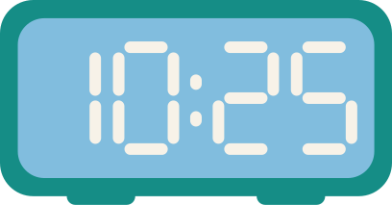
1.1. REQUIREMENTS
Press Button 2
Display time
Display date
Press Button 3
Turn off display mode
Turn on display mode
Setting date, time using UART and SPI serial communication

Slide 4
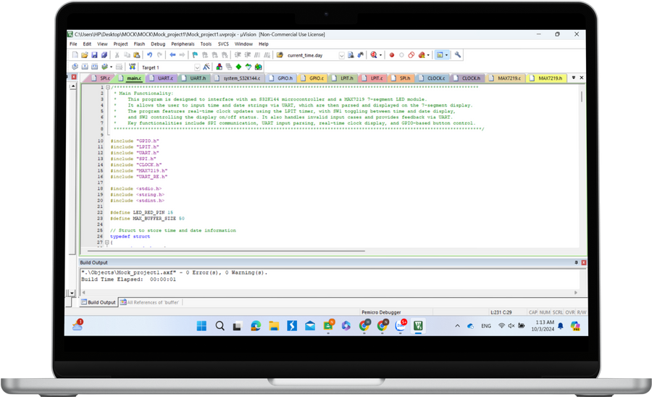
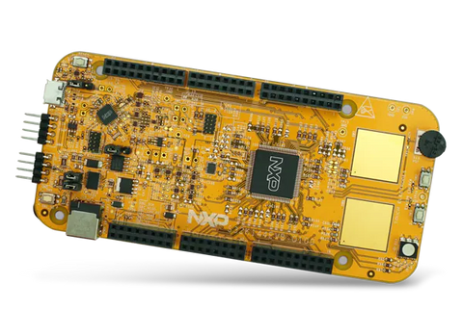
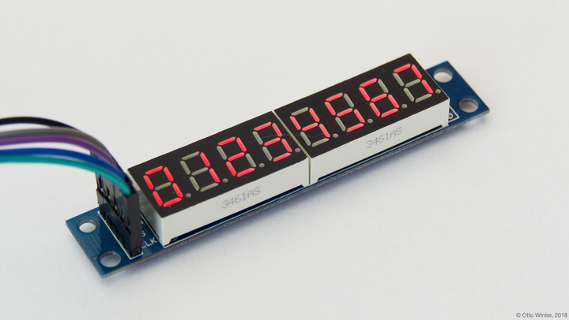
2. HARDWARE DESIGN
S32K144EVB Board:
Receive data through UART
Control Max7219 through SPI:
PTB2: SCK
PTB0: PCS
PTB1: SOUT
5V supply for Max7219
SW2, SW3: button
Display date and time
Computer:
ACC
GND
Send data to MCU
Display notification to user on Hercules

Slide 5
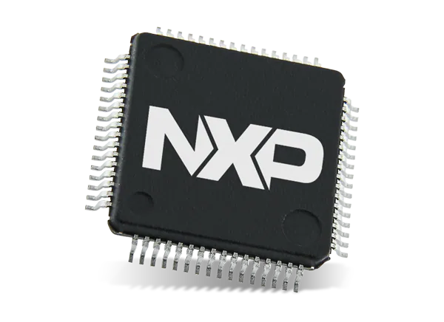
2. SOFTWARE DESIGN
2.1. PERIPHERALS
GPIO
LPIT
UART
LPSPI

Slide 6
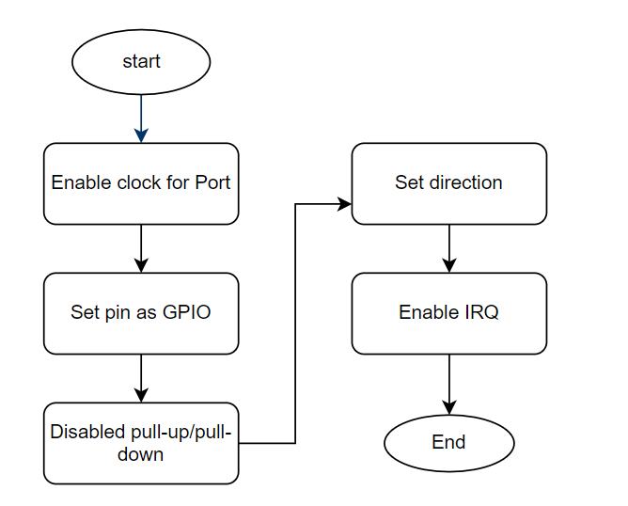
2.1.1. GPIO

Slide 7
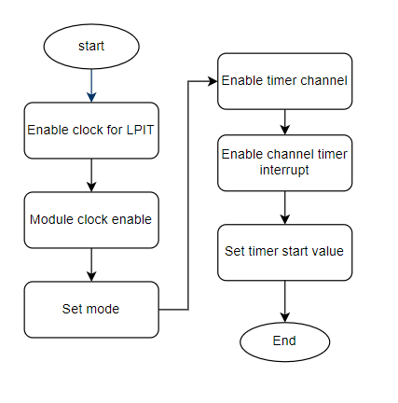
2.1.1. LPIT

Slide 8
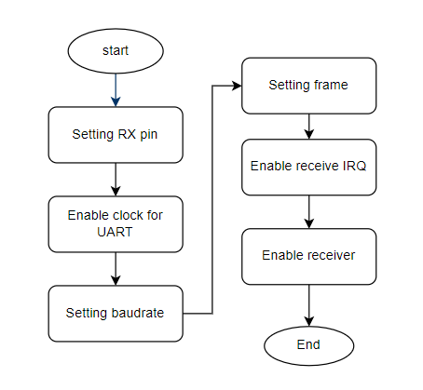
2.1.2. UART

Slide 9
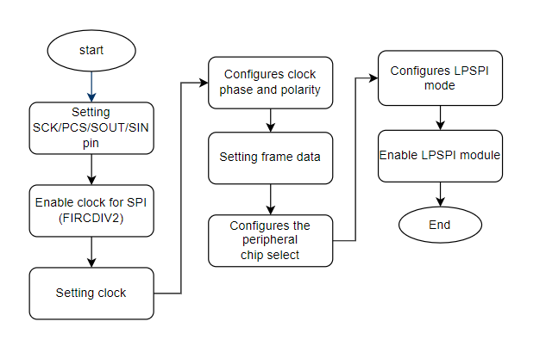
2.1.3. SPI

Slide 10
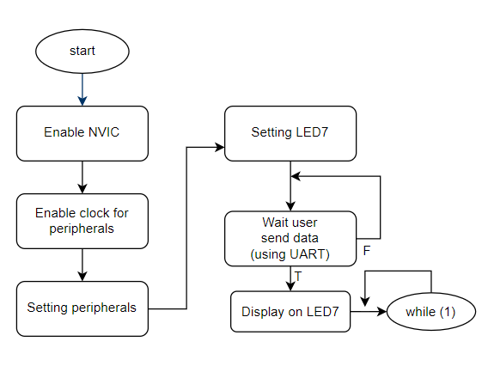
2.1.4. FLOWCHART

Slide 11
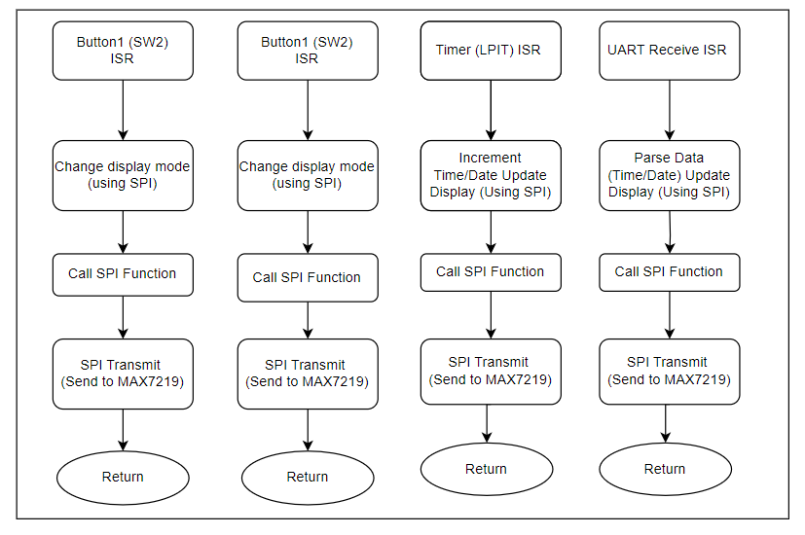
2.1.5. FLOWCHART

Slide 12
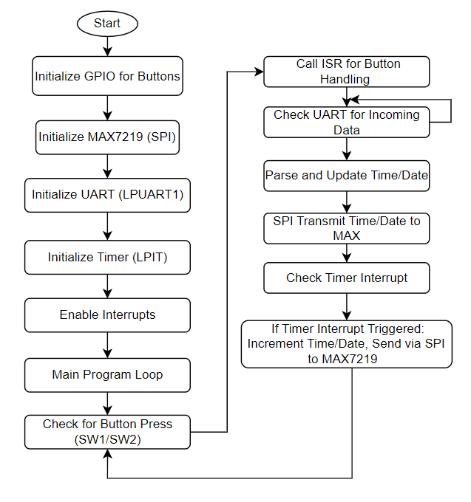
2.1.6. FLOWCHART - MAIN

Slide 13
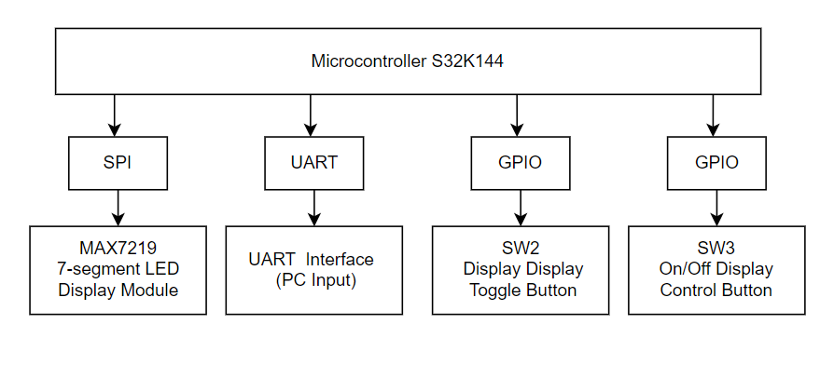
3. SOFTWARE DESIGN

Slide 14
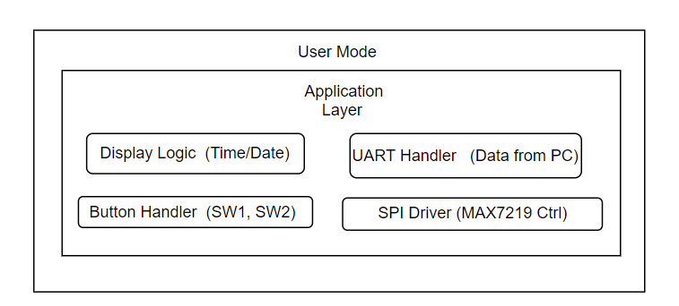
3. SOFTWARE DESIGN

Slide 15
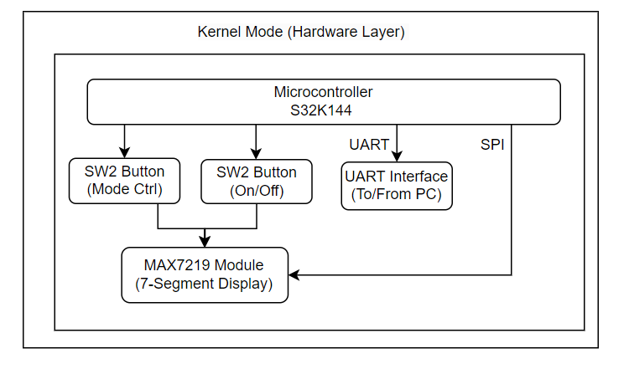
3. SOFTWARE DESIGN

Slide 16
4. User Manual
Displaying Time and Date
Enter the time or date using the syntax:
Time: t[hh-mm-ss]
Date: d[dd.mm.yyyy]
Press Button 2
Display time
Display date
Turn off display mode
Turn on display mode
Press Button 3

Slide 17
5. DEMO

